Slide 1


WQD 7001
Project Presentation Part 1
Analyzing Customer Preferences and Effective Marketing with a Data-Driven Approach to Retail Strategies
Presentation by Group 9

Slide 2
Overview
1
TEAMS
5
SCOPE & DOMAIN
2
INTRODUCTION
6
LITERATURE REVIEW
3
PROBLEMS
7
DS PATHWAY
4
OBJECTIVES
8
CONCLUSION

Slide 3





﻿Meet The Team
Kar Hong Sam
(Leader)
Jia Hui Wong
Wing Hong Cheah
Mei Zhu
Yuan Wei Kam

Slide 4

Introduction
The COVID-19 pandemic has boosted the e-commerce industry where physical retailers have shifted their business model to online which increased competition among the online retailers.
Online retailers can remain competitive through data-driven decision making by analyzing any available data like customer data and product sales.
Cross Industry Standard Process for Data Mining (CRISP-DM) is used to analyze a superstore dataset through six stages: Business Understanding, Data Understanding, Data Preparation, Modeling, Evaluation, and Deployment.

Slide 5
Problems
First Problem
Second Problem
Third Problem
There is high competitiveness among online retailers, and data-driven decision making plays a crucial role in ensuring that they remain competitive from their competitors.
Online retailers fail to extract insights from the existing available data to make data-driven decision.
Online retailers fail to understand their customer preferences and develop effective marketing strategies.

Slide 6


Objectives
To identify the most profitable products or categories to optimize sales and revenue.
To identify the best and worst performing regions/markets to optimize sales and revenue.
Develop a machine learning model to predict profitable products and improve margins.

Slide 7

Scope & Domain
The analysis will focus on sales data for all products and categories sold by Superstore
Analyze sales and profit data across different geographic regions/markets where the Superstore operates
Collect and analyse historical sales and profit data for all products/categories sold by the Superstore and use the collected data to train a machine learning model for classifying if a product is profitable or not.

Slide 8


Literature Reviews
"Data Science Innovation in Supermarkets: A Case Study of Woolworth"
Superstore analysis provides valuable insights into consumer behaviour, product trends, and market dynamics.
Analyzing data in superstores can present challenges, particularly in terms of standardizing data and identifying patterns in large datasets.
DS provides practical insights through analysis of data from various sources.
DS techniques are important for analyzing the massive amounts of data generated by superstores.
"Data Science in Supermarkets"
Notes:
Superstore analysis is crucial for modern retail management, as it provides valuable insights into consumer behavior, product trends, and market dynamics. Two recent articles emphasize the importance of using data science techniques to analyze the vast amounts of data generated by superstores to better understand consumer needs and preferences. Although superstores offer several advantages, including a wider range of products and more personalized customer experiences, challenges such as data standardization and difficulty identifying patterns in large datasets exist. Data science can help bridge this gap and aid in identifying trends and patterns in consumer behavior, leading to better decision-making and increased profitability for superstores.

Slide 9


DS Pathway
1
First
Dataset Preparation
(Obtain & Clean)
2
Second
Collaborator/ End Users
(Asking Questions)
3
Third
Exploratory Data Analysis (EDA)

Slide 10

Dataset Preparation (Obtain & Clean)
Feature | Details
Data Source | Superstore Dataset from Kaggle
Data Set Characteristics | Multivariate
Attribute Characteristics | Categorical, Numeric, Date, Textual
Associated Task | Descriptive, Predictive
Number of Instances, Attributes | 9994, 21
Remove unuse columns | ‘Row ID’, ‘Ship Date’, ‘Ship Mode’, ‘Customer Name’, ‘Country’, and ‘Postal Code’
Duplicate Values? | Yes
Add new column | 'Profit Margin'

Slide 11

Collaborator/End Users (Asking Questions)
01
Which products/categories are the most profitable?
02
Which regions/markets are performing the best/worst?
03
Are there any specific customer segments that we should focus on?

Slide 12
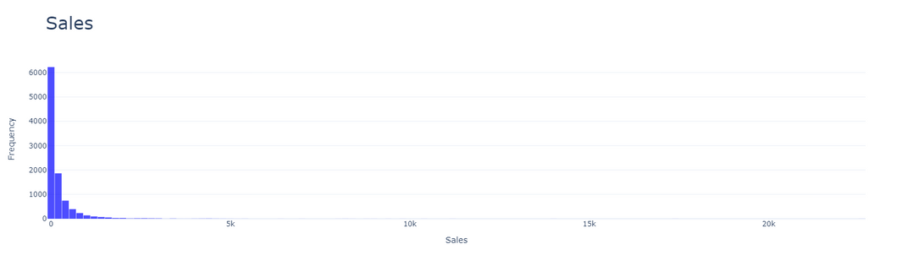
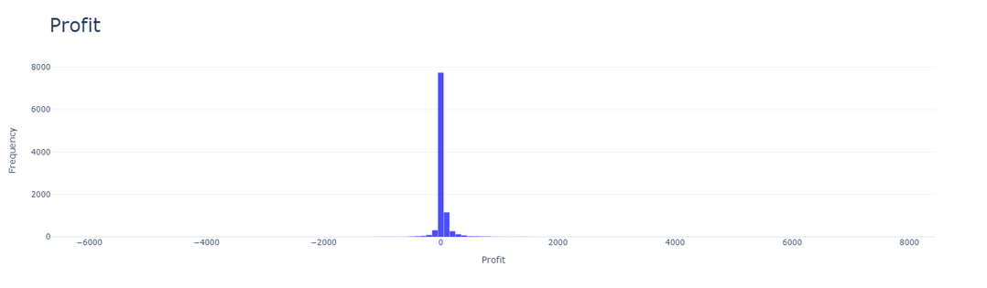
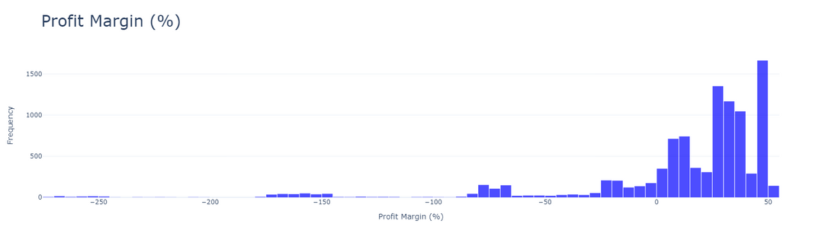
Histogram (Sales)
EDA RESULTS
Features Distribution
Sales: Rightly skewed, sales approaching 0 is having higher Frequency.
Histogram (Profit)
Profit: Profit that is approaching 0 is having the highest frequency.
Histogram (Profit Margin (%))
Profit Margin (%): Profit margin (%) that is in the positive region is having higher frequency in compared with the negative region.

Slide 13
EDA RESULTS
Sales by Category (Bar Chart)
Sales by Category
Technology products is having the most sales (840,000).
Technology
Category
Furniture
Follow by Furniture (740,000).
Office Supplies
Office supply (720,000) is having least sales.
0k
250k
500k
750k
1,000k
Profit

Slide 14
EDA RESULTS
Profit by Category (Bar Chart)
Profit by Category
Technology products is the most profitable (150,000).
Technology
Category
Office Supplies
Follow by office supplies (120,000).
Furniture
Furniture products is (18,000) the least profitable.
0k
50k
100k
150k
Sales

Slide 15
EDA RESULTS
Profit by Category (Bar Chart)
Profit by Region
It can be observed that the West Region is the most profitable accounting for 110,000.
West
East
Followed by East Region and South Region at 92,000 and 47,000 respectively.
South
Central
Central region is the least profitable by only accounting for 40,000.
0k
25k
50k
75k
100k
125k

Slide 16
﻿EDA Result
Sales by Sub-Category
Sales by Sub-Category (Cluster Column Chart)
Technology
Furniture
Office Supplies
Findings
400k
For the sales in technology category, phones ranked at first, followed by machines, accessories and copiers.
For the sales in furniture category, chairs is having the most sales, tables ranked second and followed by bookcase, whereas furnishings ranked last.
For the sales in office supplies, storage ranked first, followed by binders, appliances, paper, supplies, art, envelopes, labels and fasteners.
300k
Sales
200k
100k
0k
Phones
Copiers
Chairs
Tables
Storage
Paper
Art
Labels
Machines
Bookcases
Binders
Supplies
Envelopes
Fasteners
Accessories
Furnishings
Appliancess
Sub-Category

Slide 17
﻿EDA Result
Profit by Subcategory
Profit by Sub-Category (Cluster Column Chart)
Findings
60k
From the cluster column chart, we can see that technology products are leading in profit, followed by office supplies and furniture.
For the profit in technology products, all the products are profitable whereas copiers are the most profitable and machines is the least profitable.
For office supplies and furniture category, the products can be categorised into two categories: profitable and loss.
For office supplies, paper is the most profitable and supplies are the least profitable. Out of these products, supplies are making loss whereas all other products are profitable.
For furniture, chairs are the most profitable and tables are the least profitable. Out of these products, bookcases and tables are making loss, whereas chairs and furnishings are profitable.
40k
Profit
20k
0k
-20k
Paper
Art
Phones
Labels
Chairs
Tables
Copiers
Storage
Machines
Binders
Supplies
Envelopes
Fasteners
Bookcases
Accessories
Appliances
Furnishings
Sub-Category

Slide 18
EDA ﻿Result
Profit Margin (%) by Sub-Category
Result 2
Profit Margin (%) by Sub-Category (Cluster Column Chart)
Office Supplies
Technology
Furniture
50
From the cluster column chart, it can be observed that the office supplies are leading in profit margin, followed by technology products and furniture.
For office supplies, labels are generating the highest profit and supplies are the least profitable. Supplies is the only products in the office supplies category that undergo losses.
For technology product, all the products are having positive profit margin. Copiers is having the highest profit margin and machines are having the least profit margin.
For furniture, furnishings are having the highest profit margin tables are having the lowest profit margin. Furnishings and chairs are having the positive profit margin while bookcases and tables are having negative profit margin.
40
30
Profit Margin (%)
20
10
0
-10
Labels
Paper
Art
Storage
Copiers
Phones
Chairs
Tables
Fasteners
Binders
Supplies
Machines
Envelopes
Appliances
Accessories
Furnishings
Bookcases
Sub-Category

Slide 19
EDA RESULTS
Profit Margin (%) by
Customer Segment
Home Office
21.2%
It can be observed that the consumer segment is generating the highest profit margin by 48.4%.
Consumer
48.4%
Corporate
30.4%
Followed by Corporate segment at 30.4%.
Profit Margin (%) by Customer Segment (Pie Chart)
Home office segment's profit margin is the lowest at 21.2%.

Slide 20
Conclusion
1
This project followed the CRISP-DM methodology, focusing on exploring the data
2
Key findings:
Copiers in the Technology category were the most profitable items
The West region performed well, but the Central region requires improvement in sales
The consumer segment was the most popular and generated significant revenue
3
Three out of four research questions were addressed successfully. The remaining research question involves building a predictive model and will be pursued in the next phase of the project

Slide 21
Thank
You

